Slide 1
Week 5
Functions and Error Handling

Slide 2
Improved Function Syntax
C++ 11 introduces
Type-inference declaration
Trailing return type declaration
Trailing return type declaration
For functions that want to include type inference we need a return type declaration so the compiler can figure out what type to return

Slide 3
Improved Function Syntax pt.2
Sytatax:
auto identifier(parameter-list) -> return-type {}
Auto keyword implies variable inference
Identifer is the name of our function
Parameter-list is any external variable we want to include in our code block
-> return-type declares what type we’re returning
This was created to alleviate some intense scoped syntax
https://ict.senecacollege.ca/~oop345/pages/content/funct.html

Slide 4

Linkage
Variable an functions can have either an internal or external linkage
By default linkage is considered external, we can be redundant by using the keyword extern. Main() has to have external linkage
To specify internal linkage we can use the keyword static
// Function Linkage - Module A // linkage_b.cpp #include <iostream> static void display() { // internal linkage std::cout << "in module b\n"; } void module_b() { // external linkage display(); } | #include <iostream> static void display() {// internal linkage std::cout << "in module a\n"; } void module_b(); // external linkage int main() { // external linkage display(); module_b(); } | //Output in module a in module b

Slide 5
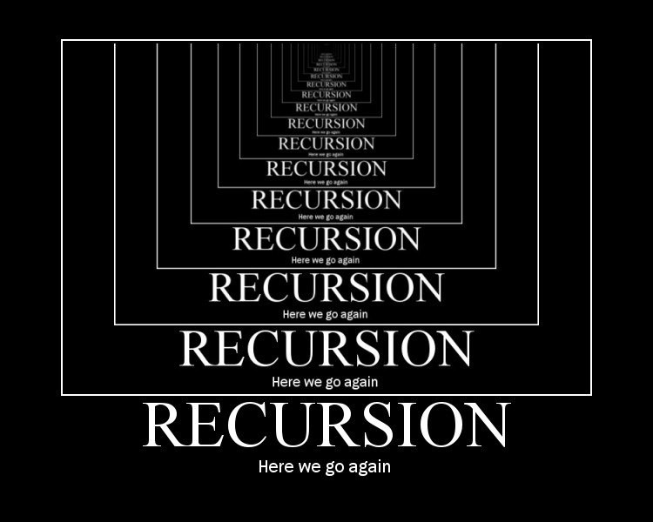
Recursion
A recursive function calls itself from its own code body
In order for a recursive function to work, it requires an “EXIT CONDITION”
Recursion uses the stack to complete its loops
If your function recurs too many times it may cause a “stack overflow”
Google Trolls Link

Slide 6
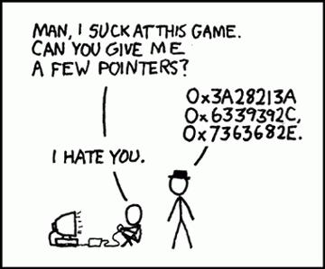
Function Pointers
Function pointers hold an address of a function
This is helpful if we want to pass functions into other functions through the parameter list
When using templates you must also specify the type when passing the function in
Ex. sort(a, n, ascending<int>);
Is the function you pass in. Is the typeing for the template

Slide 7
Arrays of function pointers
You can have an array of function pointers if they have:
the same number of parameters
same type of parameters
same order of parameters
same return type
bool (*criterion[2])(int, int) = {ascending, descending}; // ascending & descending are function names
Invoking: sort(a, n, criterion[i]);

Slide 8
Lambda Expressions
Lambda expressions are anonymous function that is usually called once. They can be nested inside other functions
It can access certain variables in it’s environment (it’s parent functions)
Syntax:
[capture-list] (parameter-list) -> optional-return-type {//function-body}
[](){} //shortest lambda

Slide 9
Lambda – Capture list
Capture lists can pass non-local variable into the body of the lambda expression
[=] specifies that the non-local variables in the code block are captured by value
Only creates a copy of the variable
[&] specifies that the non-local variables in the code block are captured by reference
Allows you to access the actual variable
By default Lambda’s non-local variables are read-only cannot change the values.
You can modify the variables if you add the keyword mutable
[]() mutable {}

Slide 10
Lambda example
Please check in blackboard under course documents for code examples

Slide 11
Error handling
When error handling in c++ you need 2 things.
Something to throw errors when they’re hit
Something to catch the errors that are thrown.
Code blocks that could potentially cause errors are wrapped in try/catch blocks

Slide 12
Try catch blocks
Try/catch block syntax looks like this:
int x=5, divisor=0; try{
if (divisor==0) throw divisor; cout<<“5/0 = ”<<x/divisor; //dividing by zero causes an error
}
catch(…){
cout<<“I can’t let you do that starfox”;
}

